Slide 1

FlexiTrack
An app to help you exercise effectively
Shubham Rathod
Dheeraj Muppineti
Prathamesh Mundada
Rishit Trivedi

Slide 2
Introduction
We have an app for those who enjoy being their own boss, are disciplined enough to monitor their progress, are night owls, and are early risers.
The AI-Powered tracker and corrector is an innovative mobile application designed to assist users in achieving proper exercise form by tracking their body keypoints during various exercises.

Slide 3
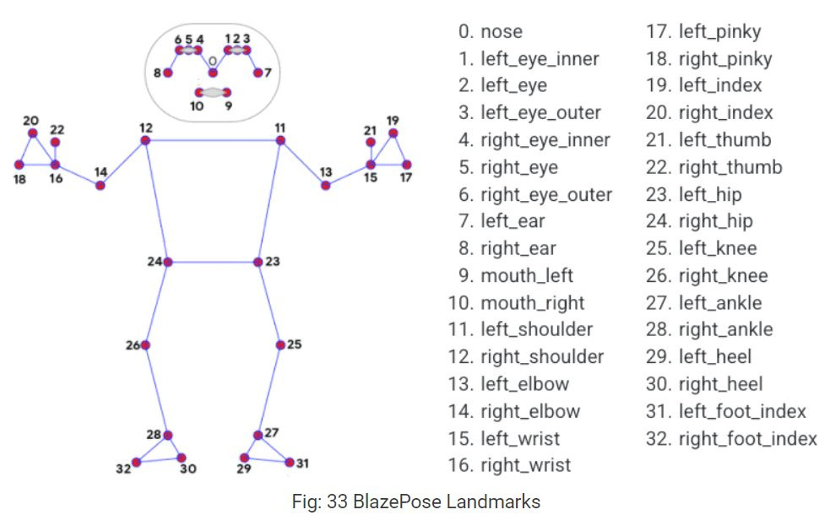
Project Description
Uses MediaPipe library and BlazePose model to estimate users' body poses in real-time.
This allows for accurate tracking of keypoints during exercises.
As users perform exercises, the app traces their keypoints, creating a digital representation of their body movements.
These keypoints are then compared to the ideal keypoints derived from the autoencoder.

Slide 4
Working
Autoencoder neural network trained on a large dataset of correctly performed exercises.
Learns the ideal keypoint positions for different exercises like push-ups, squats, plank, etc.
Compares the user's keypoints and the autoencoder's ideal keypoints, the app evaluates the user's exercise form.
Provides real-time visual feedback to users, highlighting areas where corrections are needed.
The app guides users through the correct exercise form with interactive visual cues.

Slide 5
Timeline
28th June
3rd July
10th July
Formed a team and brainstormed ideas. Decide on "Pose Correction for Exercises" as the project idea.
Conducted research on pose estimation techniques and machine learning models
Collected dataset of exercise videos with labeled keypoints and created custom datasets when required.
23rd July
18th July
14th July
Made necessary improvements
Connected the model to a cross-platform React-Native app
Implemented data preprocessing methods .
Collaborated with a domain expert to gain insights into exercise poses
Implemented the autoencoder model, evaluated it and made it ready for deployment.

Slide 6
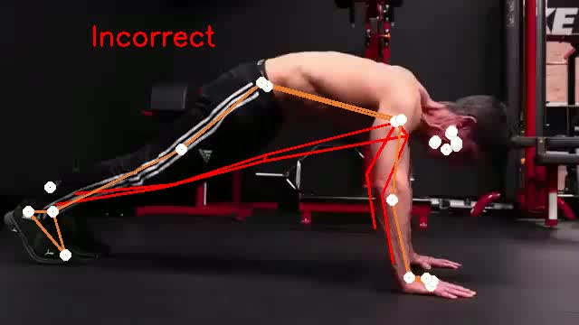
Video of FlexiTrack

Slide 7
Impact of the Idea
Improved Exercise Form
Increased Exercise Confidence
Enhanced Workout Effectiveness
Personalized Fitness Experience
Preventative Health Impact
Accessibility to Fitness Guidance
Data-Driven Insights
Empowering Trainers
Fostering Accountability
Positive Impact on Fitness Industry
Overall, FlexiTrak app can contribute to a healthier and more informed fitness community. By leveraging advanced technologies, it empowers users to exercise with confidence, reduces the risk of injuries, and supports them in achieving their fitness goals.

Slide 8
Thank You

